Slide 1
SISA Update December 2019
Robin Shaw
Manager, Self Insurers of SA

Slide 2
Overall situation
Remains very quiet at Govt level
SISA is seeking the Government’s position on the Automated External Defibrillators (Public Access) Bill 2019 tabled by Hon F. Pangallo in October.
Would have particular cost impacts on aged care, local govt, hospitals but may also affect many other classes – definitions are not very precise (as usual).
We won’t determine our position until we know the Government’s view.
Will take months to work its way through the LC.

Slide 3
Proposed changes to Workplace Exposure Standards
Were agreed to by a majority of WHS Ministers.
SA did not agree, so changes in SA unlikely.
Awaiting further info from SWSA on the SA position.
Would change WES to Workplace Exposure Limits & take other steps to emphasise that limits are mandated rather than optional.
Would also streamline process of updating.
SWA likely to reach a position in 2020 as to whether diesel emissions should be included – NSW already moving to do so.

Slide 4
Preedy case
Preedy v Return to Work Corporation of South Australia [2019] SAET 228 – rehearing of case remitted by SASCFC. Impairments to be combined and worker is seriously injured.
SASFC did not address some issues as identified in SAET 228 – possible that RTWSA will lodge further appeals with a view to returning to SASFC.
Some concern over liability impact for the scheme – a number of cases have been awaiting Preedy.
SISA advises members to review relevant claims including those settled by deed or consent orders

Slide 5
Implications of Preedy
If the current position stands, some claimants who settled without impairments being combined may seek further reviews with the aim of obtaining SI status or additional lump sums – no idea how many of these there may be.
If a worker succeeds in getting SI status, economic loss lumps become recoverable or subject to offset against backpay etc. Older workers might not try.
Deeds and consent orders would need review – do they remain effective or are they voided by Preedy?
Suggest consulting lawyers & actuaries.

Slide 6
SAET proposals for revised case management
Proposes a two-stream model aimed at improving the efficiency of dispute management and compliance with SAET orders.
SISA feedback was guarded approval. No sound reason to object but hard to tell how it will work in practice.
In theory anything that reduces the number of adjournments and improves diligence of parties is good.
Feedback has been acknowledged but no advice yet as to whether the proposals will be implemented.

Slide 7
Recent SAET cases
Firkins v Return to Work SA & BAE Systems Australia [2019] SAET 231 – worker injured while living & working overseas. Held to be a worker under the Act.
Walker v Return to Work SA [2019] SAET 201 – held that impairments of mastication and deglutition are not related to a psychiatric impairment.
McGee v Local Government Association Workers Compensation Scheme [2019] SAET 207 – ongoing matter relating to s.18 obligations of members of a group of Sis
Breen v Return to Work Corporation of South Australia [2019] SAET 208 – worker sought hearing aids from scheme while also receiving them from the Cth – rejection upheld

Slide 8
Recent SAET cases
Rizovski v City of West Torrens; Local Government Association Workers Compensation Scheme [2019] SAET 209 - application to join proceedings for unfair dismissal with proceedings for weekly payments and medical expenses – application denied.
Fulton v SA Police [2019] SAET 210 – worker granted interim SI status on the basis of a likely 30+% assessment under GEPIC.
Mujakovic v Return to Work Corporation of South Australia [2019] SAET 211 – organic and non-organic causes of sexual dysfunction – held that AMA5 & IAGs were not complied with as organic causes were not identified.

Slide 9
Recent SAET cases
Department of Premier and Cabinet v Schmidt [2019] SAET 219 – worker had gastric bypass surgery after compensable knee injury. Cost of surgery held to be compensable.
BI (Contracting) Pty Ltd v David Jones Ltd [2019] SASCFC 138 – worker died of asbestosis in 2008 after working in roof space of David Jones in late 60s & early 70s. Steel parts of roof space had been sprayed with asbestos lagging by BI in 1960s. DJs settled claim then sought contribution from BI, which appealed. Held that BI knew at the time of the spraying that asbestos was very dangerous but did not properly inform DJs. BI found to be liable for a 75% contribution to settlement.

Slide 10
SISA news
Closing the Loop presentations feedback generally positive.
Planning for 2020 event has started.
Looking to include more solid WHS topics.
Upgrade of sponsorship to allow individual session sponsors.
Xmas drinks 13/12/19 at Wakefield Hotel.
SISA still open to suggestions for further training.

Slide 11
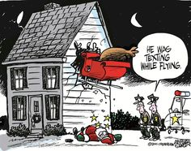
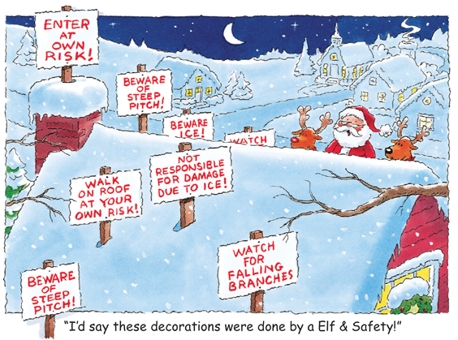
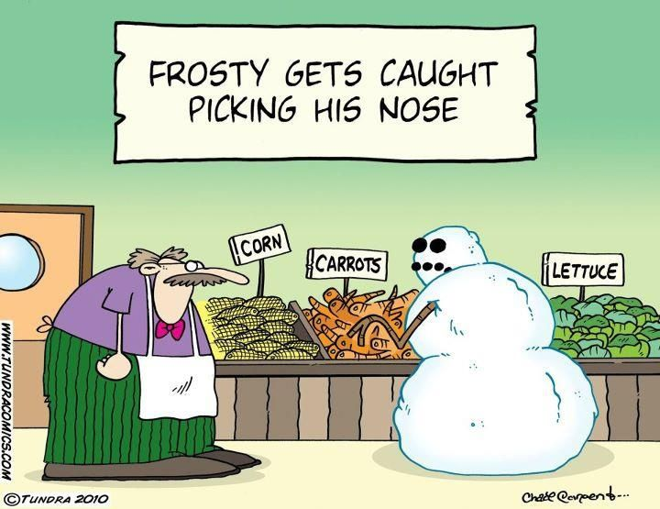
Questions?

